Slide 1

Weather Insights Project
Final project by: Noam Rippa , Maor Hamay ,Gil Levkovitch
Our Project in GitHub: GitHub

Slide 2

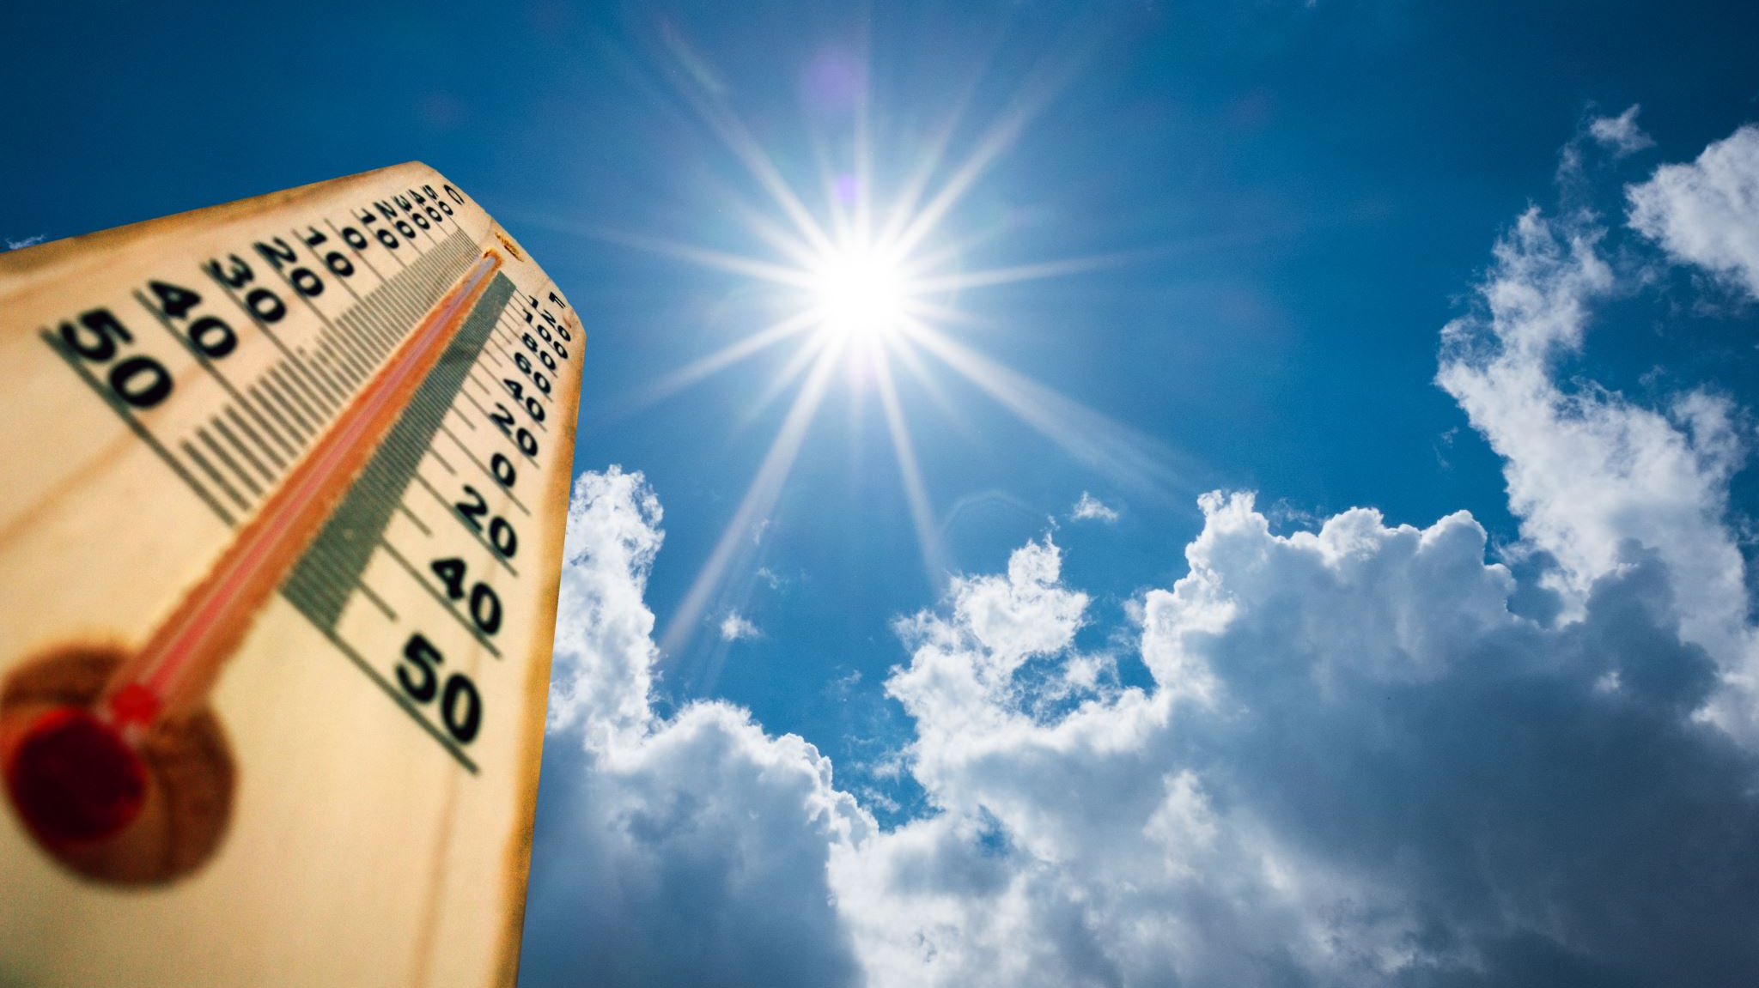
Research Questions
On this project we used 3 main questions on the weather aspect:
1.Is it possible to forecast average humidity level on a following year based on the humidity level in the previous year?
2.Is it possible to forecast average wind speed on a year based on the previous year?
3.Is it possible to predict a following year average temperature based on the previous years before ?

Slide 3
Why we chose this subject?
We chose this subject because we are concerned about the climate changes.
Today we as a society more aware of global warming situation that occurs around the globe.
We hoped that by this project we will predict details about the weather that concerns us all and maybe will have a pinkish picture about all this situation .
Hope this project will open our eyes that from here it might get worst and that we might act quickly to help this beautiful planet to survive more decades!
Thank you all for being here today , hoping you will get some info about the climate.

Slide 4



So… little background information

Slide 5
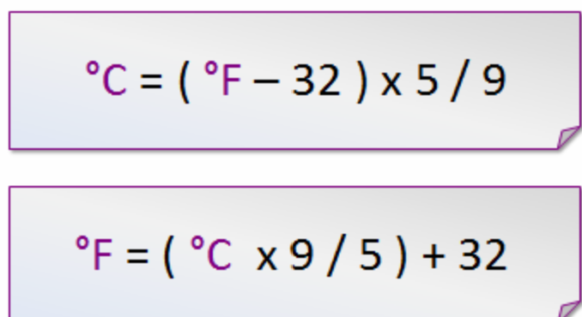
What is the Fahrenheit unit?(°F)
Usually , the Fahrenheit unit is the official unit use to size temperatures in the U.S. It is currently defined by two fixed points: the temperature at which water freezes, 32°F, and the boiling point of water, 212°F.
In the rest of the world, the official unit used to size temperature is Celsius.
If we want to get into details , the exact conversion from f to c is :

Slide 6


What is the External Resources we used?
Wikipedia
Weather Underground

Slide 7





The Project by Steps
Data Acquisition
Data Cleaning
Advanced research analysis
EDA- visualization
Machine learning

Slide 8

Crawling and Data gathering

Slide 9
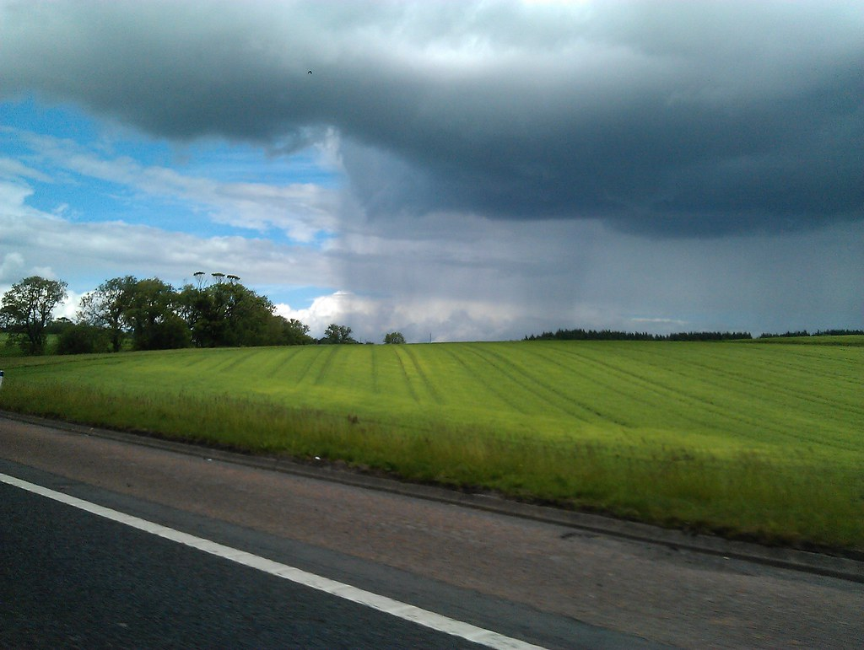
Web crawling
After trying to use Beautiful Soup on various pages, we run into a problem which the website consider us as a bot.
Because this obstacles we came to conclusion that the best way of getting data from our source is doing selenium.

Slide 10
Selenium Web-driver
Dynamic language website
We used Selenium to extract the information and save it on the computer by using the following code

Slide 11
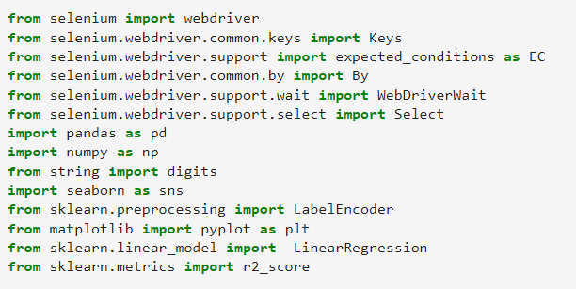
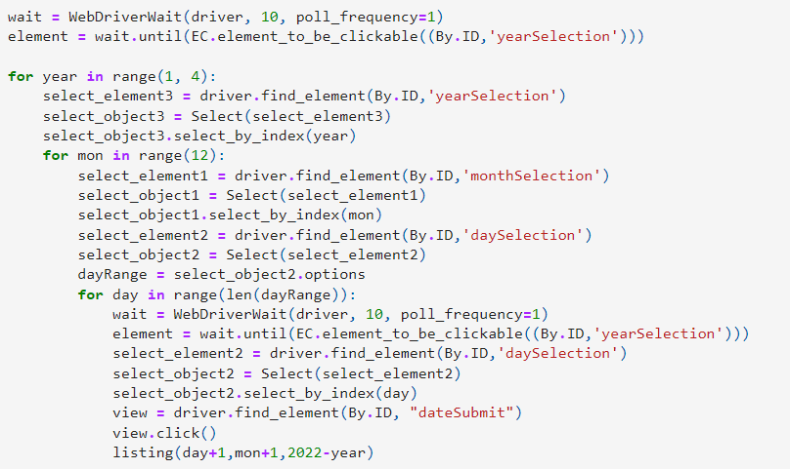
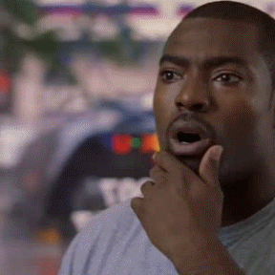

Slide 12
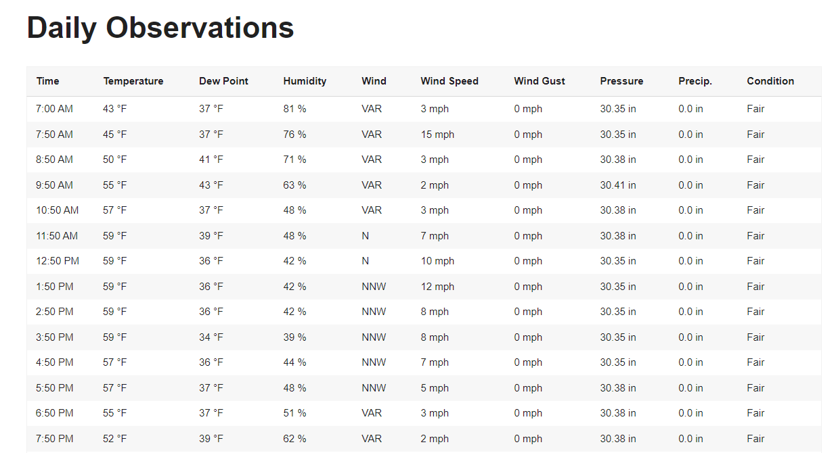
Daily observation by selenium

Slide 13
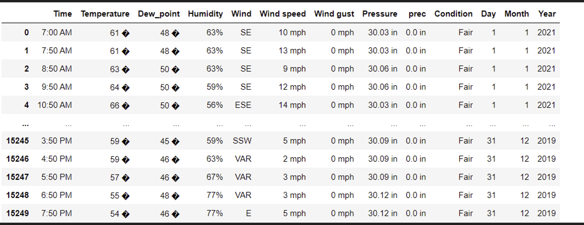
Daily observation by selenium

Slide 14
Data Cleaning

Slide 15
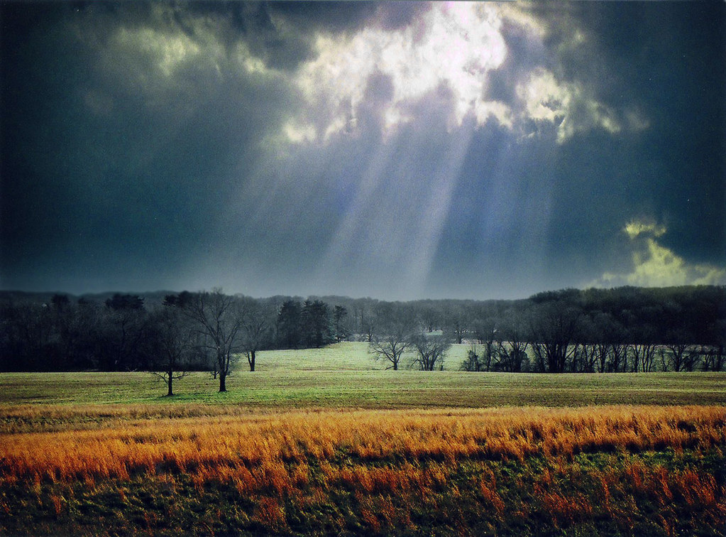
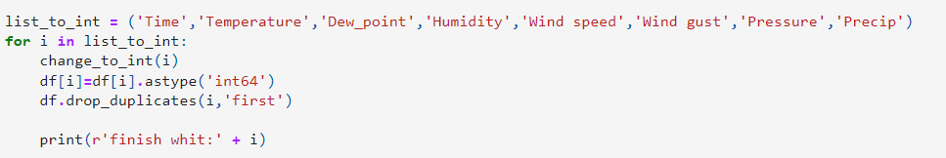
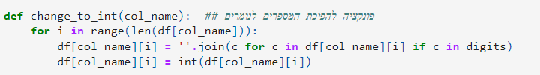
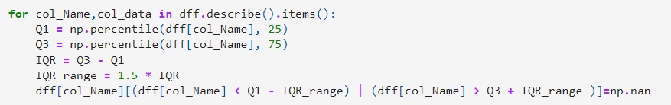
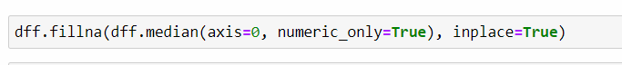
המרה של ערכי הטבלה לערכים נומריים והורדת שורות עם כפילויות
Dealing with Objects values and convert to numeric values.
Dealing with outliers
Dealing with Null values
המרה של ערכים לא נומריים לערכים נומריים בהתאם לפי עמודה
טיפול נתונים חריגים
והמרתם לערכי
None
הכנסת ערכי הממוצע לערכים שנמחקו (לערכים שהיו חריגים)

Slide 16
EDA- visualization

Slide 17
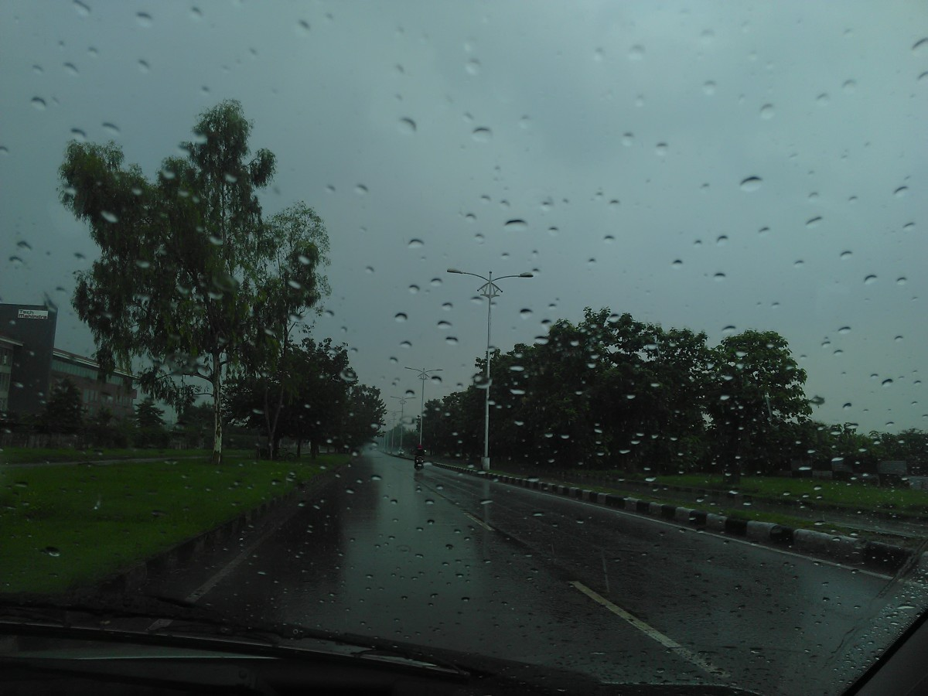
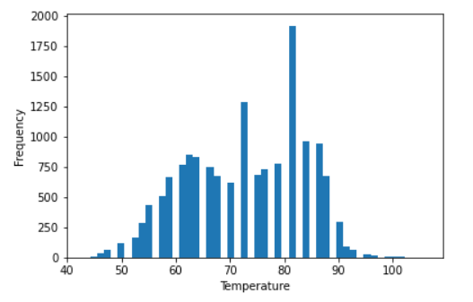
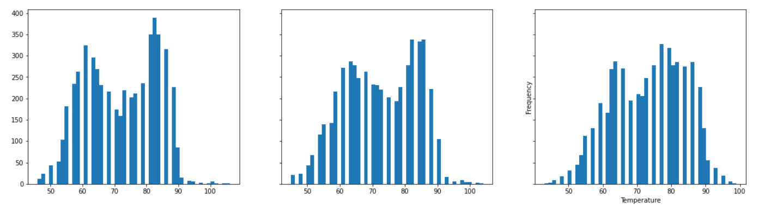
Total
2019
2020
2021

Slide 18
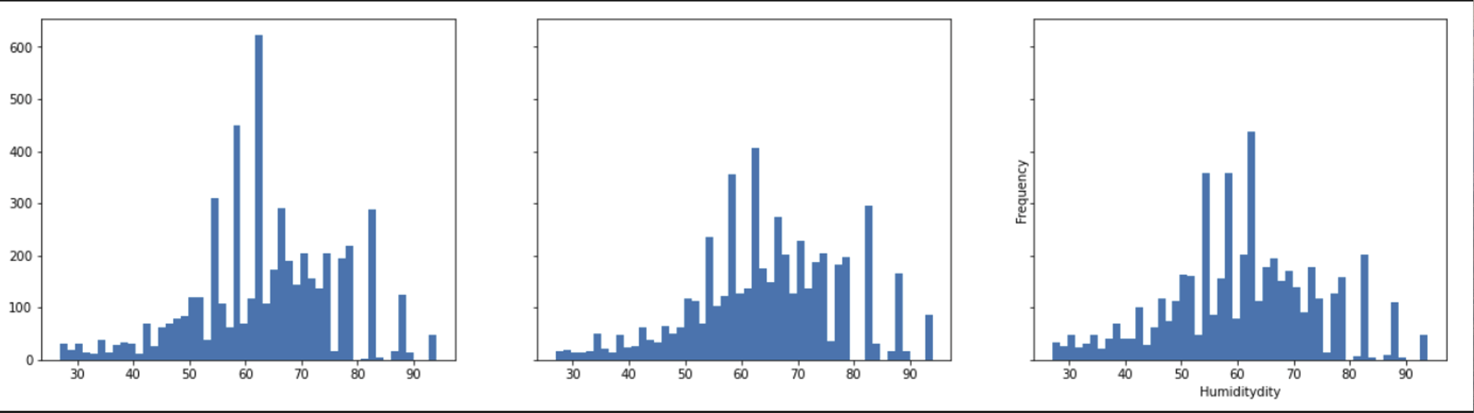
Humidity
2019
2020
2021

Slide 19
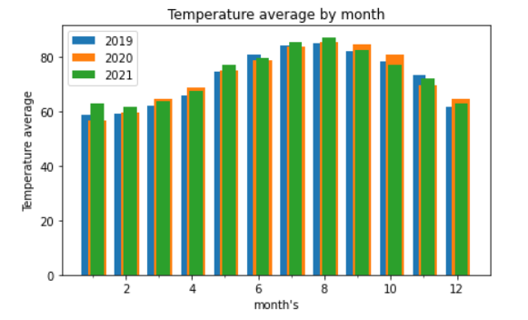
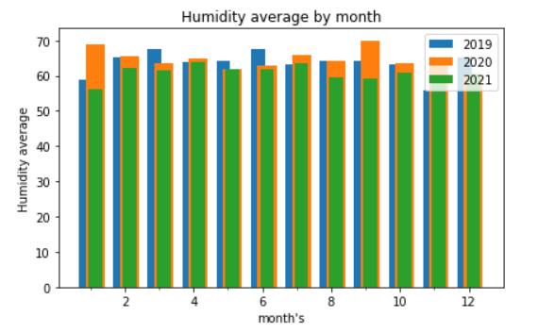
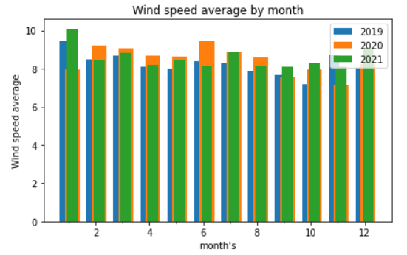
Avg Temperatures by month , wind speed and humidity

Slide 20
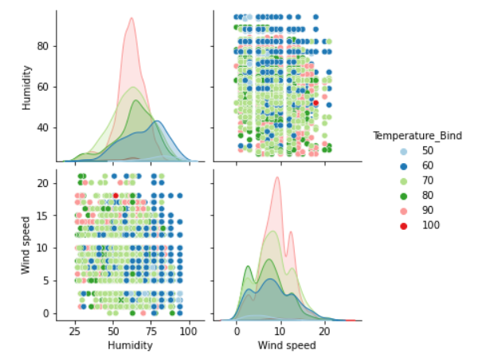
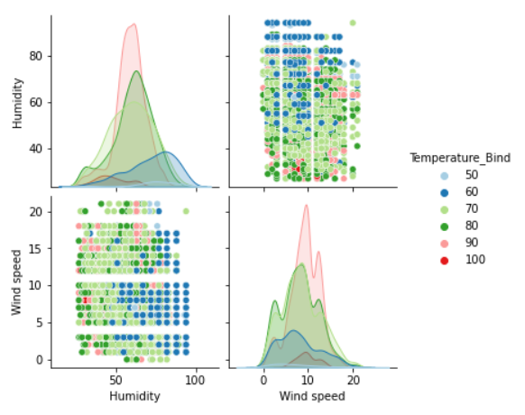
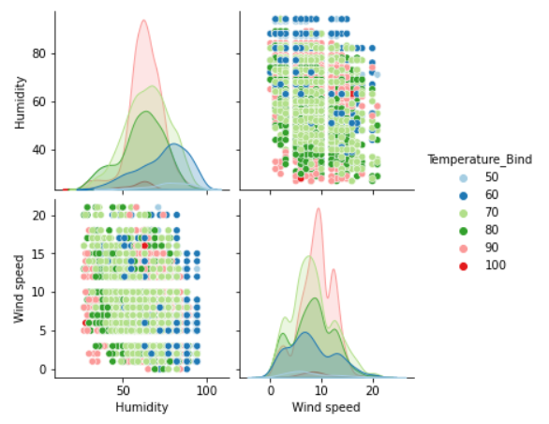
Correlation –temperature , humidity ,windspeed
2021
2020
2019

Slide 21

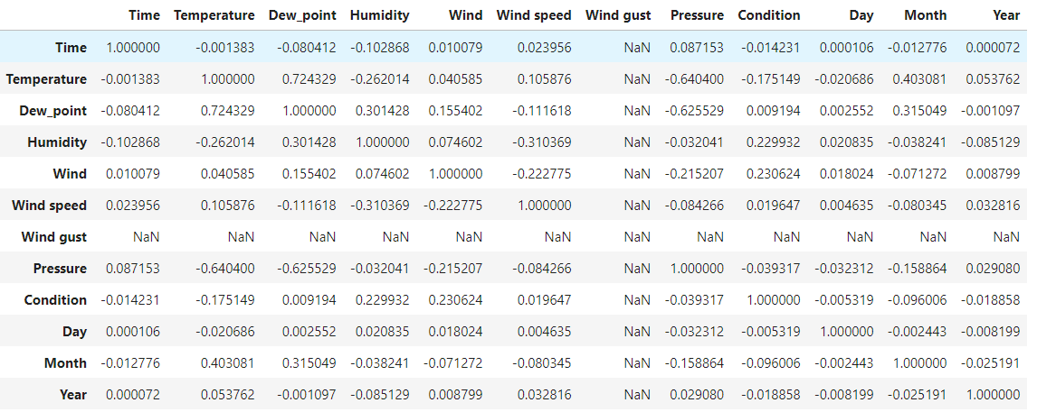
Correlation table-by code

Slide 22
Machine Learning

Slide 23
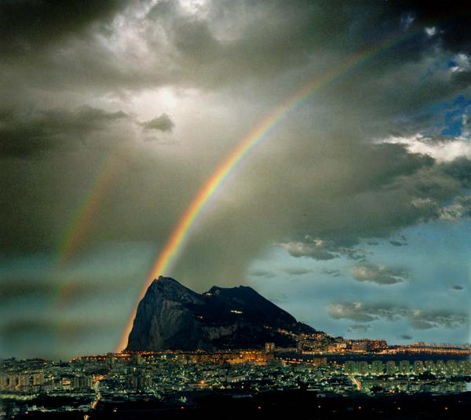
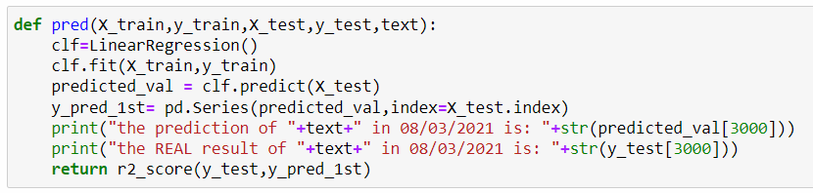
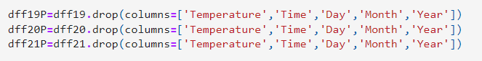
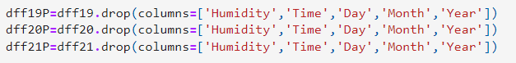
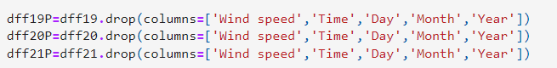
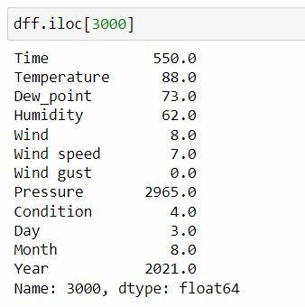
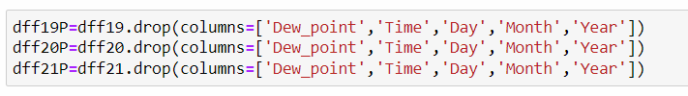
Linear regression - sklearn
By using sklearn we decided to apply Linear Regression which helps us to train a model that predict average of temperature, humidity and wind speed

Slide 24
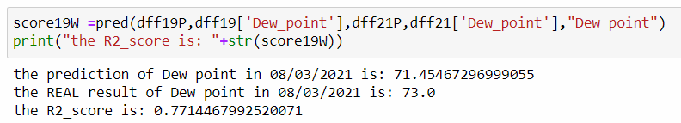
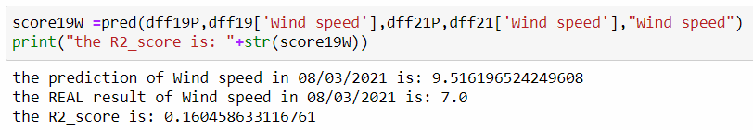
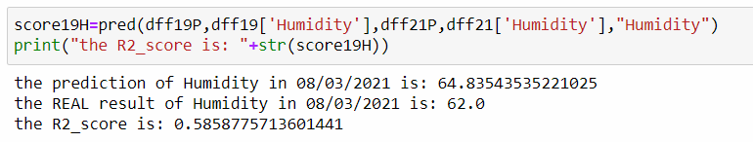
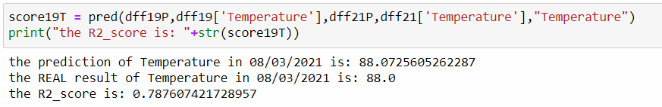
Prediction
2019 to 2021
Dew point prediction:
Windspeed prediction:
Temperature prediction(in f):
Humidity prediction:

Slide 25
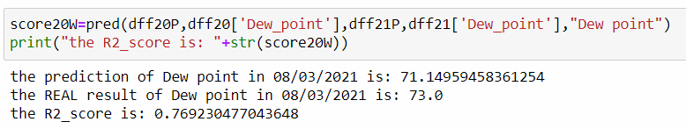
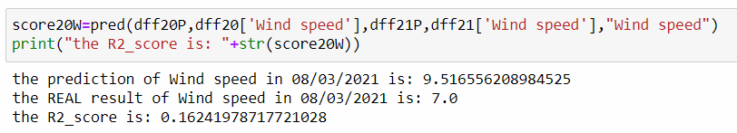
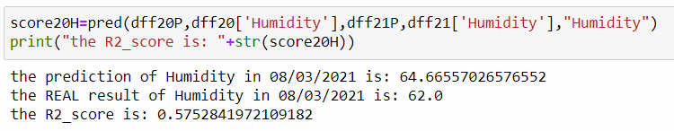
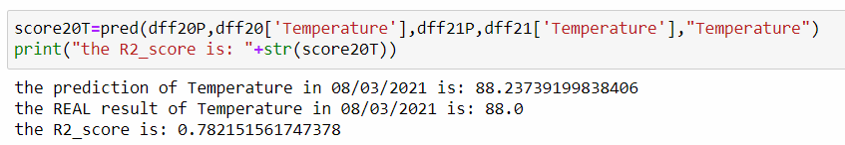
Prediction
2020 to 2021
Dew point prediction:
Wind speed prediction:
Temperature prediction(in f):
Humidity prediction:

Slide 26
Conclusions

Slide 27


So just before the end…
So after we learned and gained on the climate , our conclusions of the project are:
1.Hard to predict wind speed-
as much as we looked into it , we couldn’t predict by the wind speed of a year about the wind speed of the following year. Therefor we took in conclusion that the factor that can be predicted is the dewpoint so we changed it
2.Take a subject that is close to your interest-
after changing our main subject for too much , we came with the most talked topic which is weather and climate , its interesting to us as we are as a young people see the changes in the weather because the global warming.
3.Work together!-
Explore together !- while doing the work done together you can benefit and learn from each other! Team work is the main key to successes!

Slide 28

Thank you for listening!

